Slide 1
Multi-Modal Propaganda Classification in Online Memes
John Rodriguez & Ian Scarff

Slide 2
Introduction

Slide 3
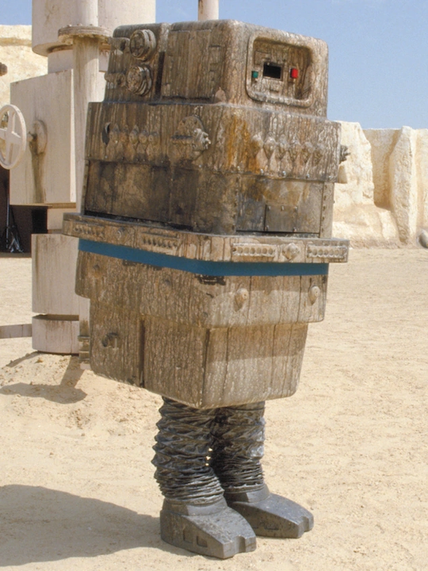
Presentation Overview
Things to discuss:
SemEval competition
Purpose/Motivation: Proliferation of memes
Project Activities
Required Methods
Gonk Droid - Source: starwars.fandom.com
Notes:
In this presentation we will be covering the following topics:
Semeval competition (what is it and why?)
The project purpose and motivation, which we will go into more details in later slides but for now think about the proliferation of internet memes.
A condensed version of the activities that occurred as we worked on our project
And the required methods to achieve our goal.
Because our model performance was better than we hoped but still left much to be desired, we decided to call our Model Architecture: the Gonk Droid. For those unfamiliar with Gonk, it is a robot in the Star Wars universe that has a very simple artificial intelligence and can understand rudimentary commands. Their purpose was usually to recharge equipment and vehicles but were typically used as comedic relief as they had low-levels of intelligence and made a ‘gonk’ sound. (https://www.starwars.com/databank/gonk-droid and https://starwars.fandom.com/wiki/GNK_power_droid)

Slide 4
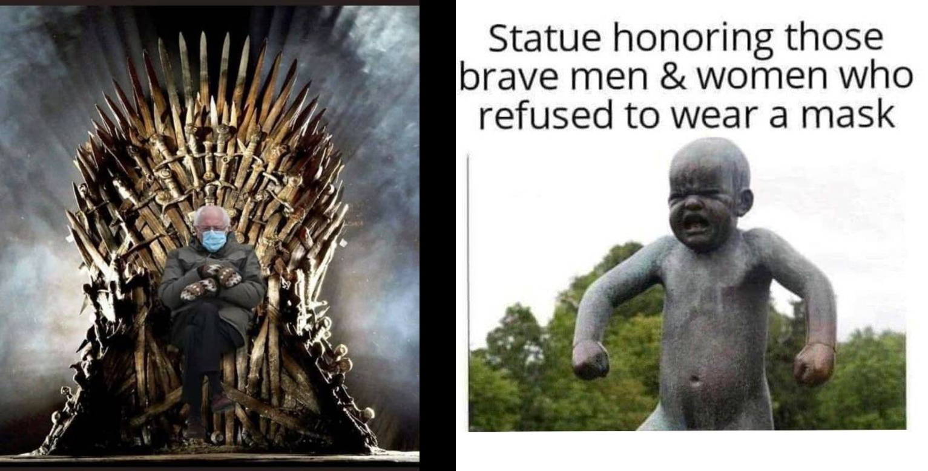
Introduction: SemEval Competition
SemEval 2021:
Task 6 - Detection of Persuasive Techniques in Text and Images
Organized by: Giovanni Da San Martino, Hamed Firooz, Preslav Nakov, Fabrizio Silvestri
3 sub tasks - Textual Context, Textual Context + Span of Text, Multi-Modal Multi-label Classification
Sub-Task 3- Multi-Modal Multi-label Classification
Data: Meme (text and image, with multi-labels)
Task: Classify based on both modalities and apply the correct set of labels to each selected item.
Source: krqe.com
Notes:
SemEval (Semantic Evaluation) began in 1998 and is an ongoing evaluations of computational semantic analysis systems. (https://en.wikipedia.org/wiki/SemEval) The project team picked the SemEva 2021l Competition as their source for their project task because of the relevance to the NLP course and to address a real world challenge. The tasks were broken out into Lexical Semantics, Social Factors and Opinion, Information in Scientific & Clinical Text and other phenomena. The project team selected Social Factors and Opinion: Task 6 - Detection of persuasive techniques in text and images. The task was organized by Giovanni Da San Martino, et al.
But first let's define some items to provide additional context. Multi-modal can be defined as communication or data that uses multiple semiotic systems. Semiotic is the method of how meaning is communicated. In this project, images and text. Multi-label implies that multiple labels can apply to a given image and text, consider movies that can fall into two or more distinct movie genres. For example, Alien is both scifi and horror.
Within the task, there were additional sub tasks and the team focused on sub-task 3: multi-modal multi-label classification. The data is a set of images, text and labels. The goal is to classification the multi-labels based on the multimodal nature of the data. (more details to come, in data section)
Meme: The first image on the right shows a playful take on Bernie Sanders during the 2021 presidential inauguration. The second image on the right was taken from semeval task 6 development images, it represents a more targeted meme meant to illicit negative responses or behaviors.

Slide 5

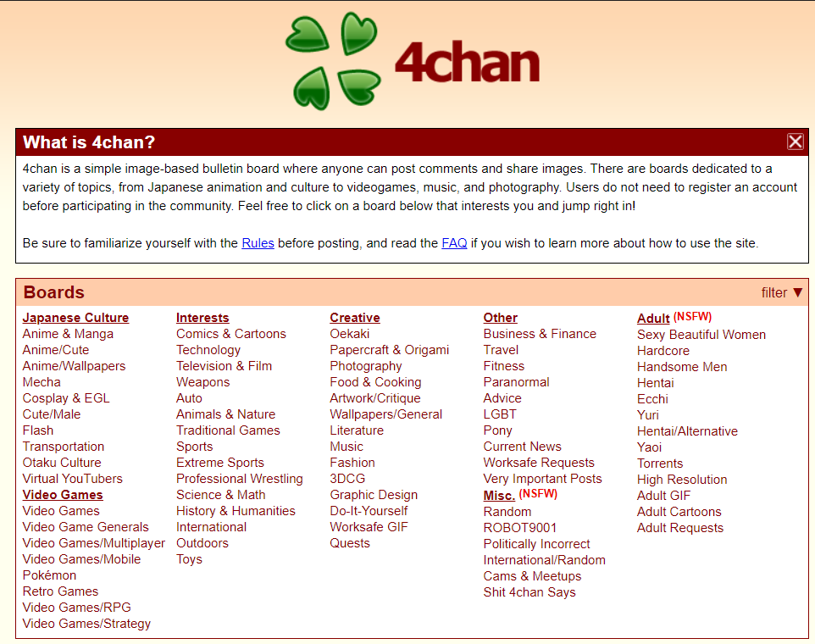
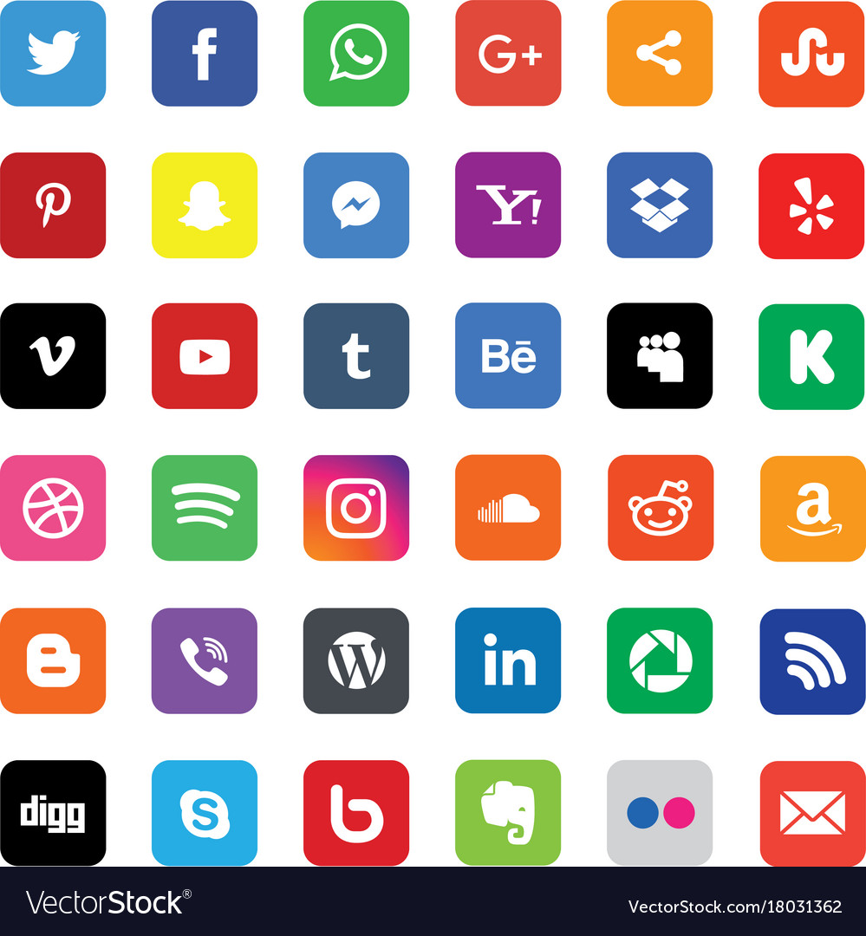

Introduction: Purpose and Motivation
Source: monkeylearn
Purpose
Classification
the various techniques of propaganda in memes
Method
Use NLP and computer vision DNN.
Motivation
Proliferation of Propaganda
4Chan
Social Media
Darkweb
Identification
Source: 4chan
Source:Thomas Bethge / Croc80 / Getty Images
Notes:
With regards to this project, the research proposed is as follows: Classify the various techniques of propaganda in memes using multi-modal AI methods.These methods will include models and deep neural network algorithms used in NLP and computer vision.
Given the proliferation of propaganda using mod-ern channels such as the internet and various sub-channels as social media, 4chan, dark web, etc.,a need has arisen to identify memes that contain harmful messages that spread false information,drive violent behavior, and lead to lawlessness. The goal of this project is to utilize NLP and computer vision to efficiently and accurately classify memes that are considered to be propaganda.

Slide 6
Literature Review

Slide 7
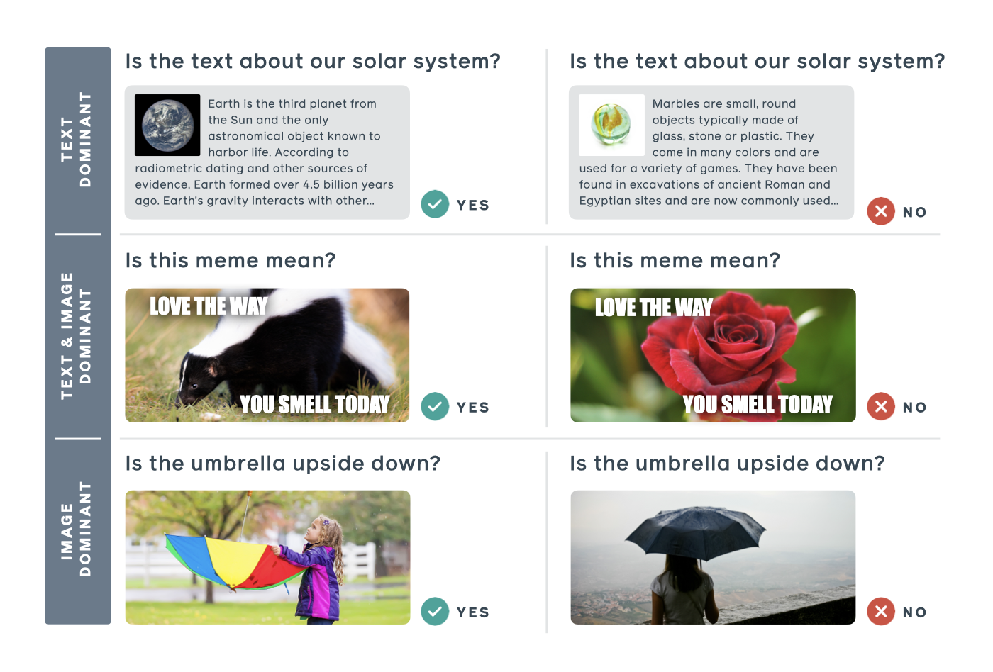
Literature Review
Published Papers
Kruk et. al., 2019
Suryawanshi et. al., 2020
Wang et. al., 2016
Devlin et. al., 2019
Victor Sanh et. al., 2020
The study of memes
Facebook’s Hateful Memes Challenge (Kiela et al., 2020)
(Afridi et al., 2020)
Source: Facebook AI
Notes:
Papers:
1. Kruk et. al. Demonstrated the use of multimodal architectures on Instagram images and their associated captions to classify them based on three taxonomies: intent, contextual, and semiotic. They also showed that using both the image data and the text data together to make predictions leads to better accuracy when compared to using the data separately. In our project, we also experimented with single modal and multi-modal methods.
2. Suryawanshi et. al. stated that Memes present a challenge for NLP due to their multi-modality nature in conjunction with the usage of humor and sarcasm.
3. Wang et. al. Introduced the CNN-RNN framework. This framework uses the image embedding produced by a CNN as the inputs to a RNN (Recurrent Neural Network), which model conditional relationships between time-steps.
4. Devilin introduced the Bert architecture. BERT builds upon other NLP techniques and is focused on utilizing a pretrained model that permits sentence level tasks such as natural language inference and paraphrasing. The goal is to predict the relationships between sentences and analyze them together.
5. Victor Sanh et.al. implemented Distilbert based on the Bert paper that was smaller, faster, cheaper and lighter than the original Bert architecture via distillation.
Meme Study - Memes specifically were the subject of study in Facebook’s Hateful Memes Challenge (Kiela et al., 2020). With the vastness of the internet, it is practically impossible for humans to sift through countless of memes to identify hate speech. Thus, there is the need for automation through AI. The goal of this challenge was to construct and implement multi-modal models for classifying hate speech. The authors of the challenge designed their dataset such that uni-modal models would under perform multi-modal models. Even then, as a baseline, they showed that even state-of-the-art models struggled compared to humans.
Memes are still avery open research topic. (Afridi et al., 2020) conducted a survey to offer a generalized view of the challenges modeling memes present, what the current advanced techniques for classification are, and discuss ongoing research into memes classification, memes reasoning, memes semantic entailment, and multi-modal fusion and co-learning.
As can be seen by the graphic, unimodal is easy to figure out for both a computer and a human (Top and bottom Row) But the middle row, the multi modal, can be difficult for a human and a computer. This is why having a computer assist with determining an image to be propaganda is vitally important.

Slide 8
Data

Slide 9
Data Provided
3 Datasets:
Training
687 Observations
Dev
63 Observations
Test
200 Observations
Gold Labels added at a later date
Data:
Image of meme
Text in meme
Labels (most are multi-labels)
Converted into one-hot encoded vectors
Notes:
Data provided by the competition. During the competition, only the train and dev set had gold labels.
Test labels were added at a later date. Since we have labels for all datasets, we merged them.

Slide 10
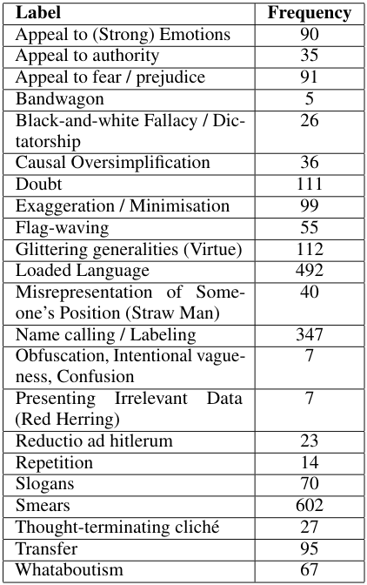
Data Merging
687 Obsv
Training
63 Obsv
Dev
200 Obsv
Test
Remove 29 Obsv
Remove 3 Obsv
Remove 4 Obsv
Bandwagon: 7
Obfuscation, Intentional vagueness, Confusion: 7
Presenting Irrelevant Data (Red Herring): 7
Merged
914 Obsv
Hold Out
80%
20%
Bandwagon: 2
Obfuscation, Intentional vagueness, Confusion: 3
Presenting Irrelevant Data (Red Herring): 3
Bandwagon: 3
Obfuscation, Intentional vagueness, Confusion: 4
Presenting Irrelevant Data (Red Herring): 4
Training
Test
727 Obsv
187 Obsv
Notes:
To merge the data, we took the three datasets and:
Removed observations with no labels
Merged them into one dataset
Here are the label frequencies. Notice that three of them have very lower frequencies.
If we were to have done a random split, it was highly likely that some may only appear in training, and not in testing. Will explain in next slide.
To combat this, we:
Held these observations out
Did a random split on the remaining data
Inserted at random location in training data
Inserted at random location in test data

Slide 11
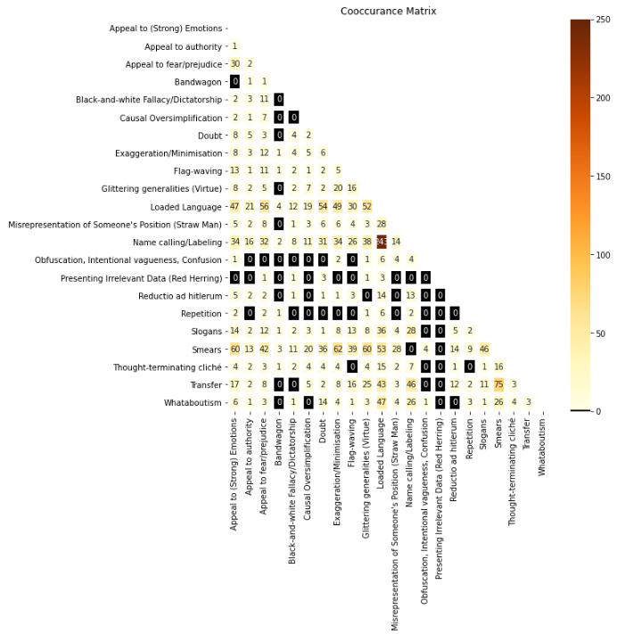
Notes:
From this graph, we can see that certain labels are highly correlated with other labels. That’s why did the hold out.

Slide 12
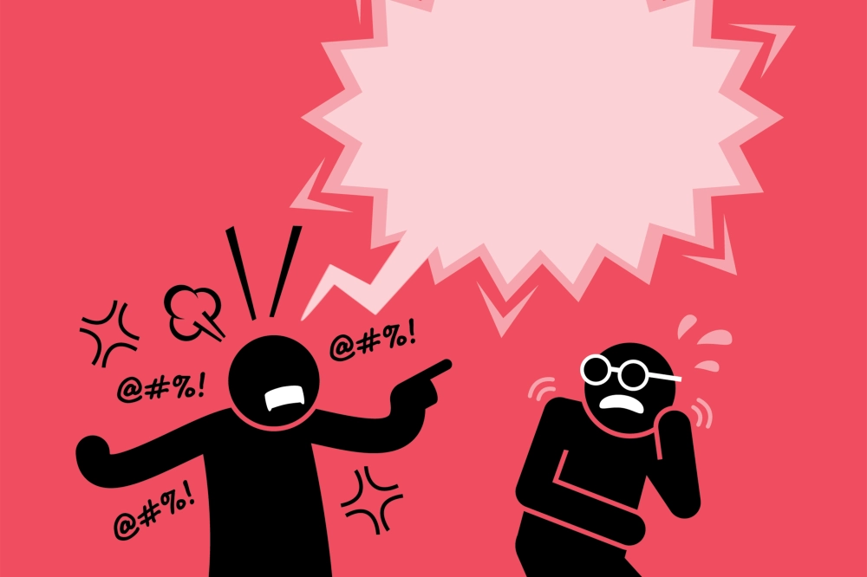

Augmenting Data with Hatespech and Sentiment Metadata
Derived Metadata
Hate Speech
SonarHate Package
Source Data: Text Data from Project
Output: Hate Speech, Offensive Speech and Neither
Sentiment
Using Hugging Face Transformer Pipeline
Source Data: Text Data from Project
Output: Positive, Negative
Source: ISTOCK / GETTY IMAGES PLUS
Source: TranslateMedia
Notes:
In order to further assist our DNN, we decided to augment the text data with additional derived metadata.
The first metadata attribute was for Hate Speech Classification. The team used a python library called HateSonar. It allows you to detect hate speech and offensive language in text, without the need for training. You have only to fed text into HateSonar. It detects hate speech with the confidence score. It is based on work from a paper titled: "Automated Hate Speech Detection and the Problem of Offensive Language" By Thomas Davidson Et. Al. (2017).
The classification are 3 domain values: hate speech, offensive speech or neither.
The second metadata attribute was for Sentiment Classification. The team used a python library called transformers published by HuggingFace, also the publisher of Bert/Distilbert. The model is pre-trained and all that is required is to feed it the text that is required to be classified. It leverages a fine-tuned model on sst2, which is a GLUE task.

Slide 13
Methodology
Notes:
Reiterate the use of single modal and multi modal.

Slide 14
Methodology: Image Modeling

Slide 15
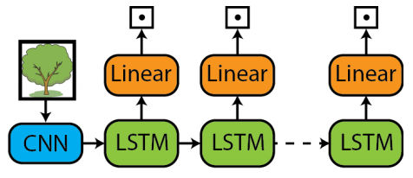
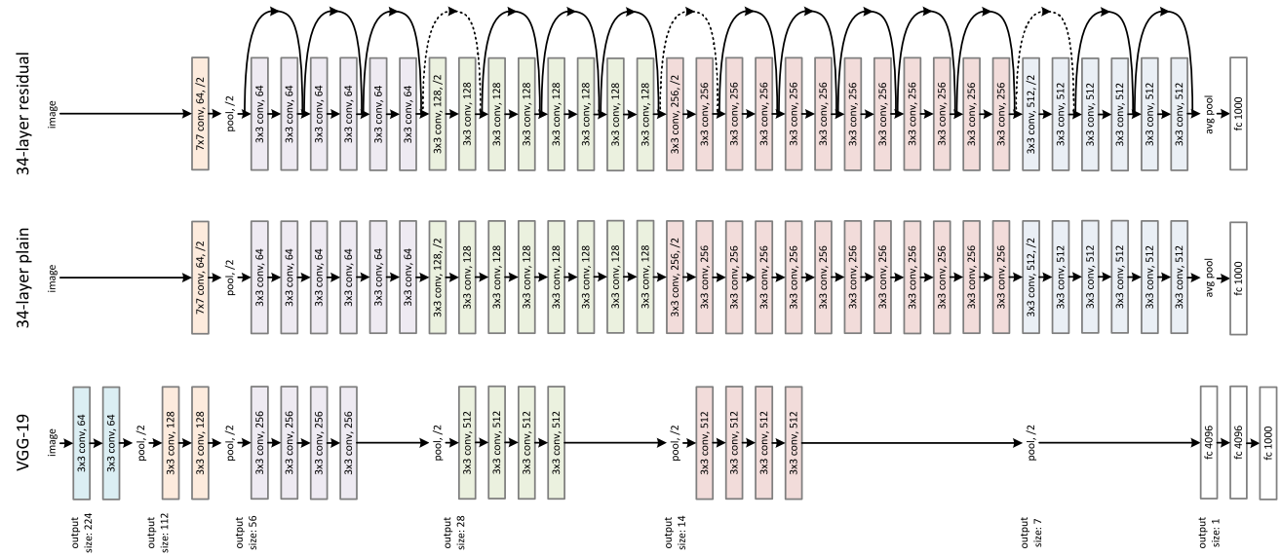
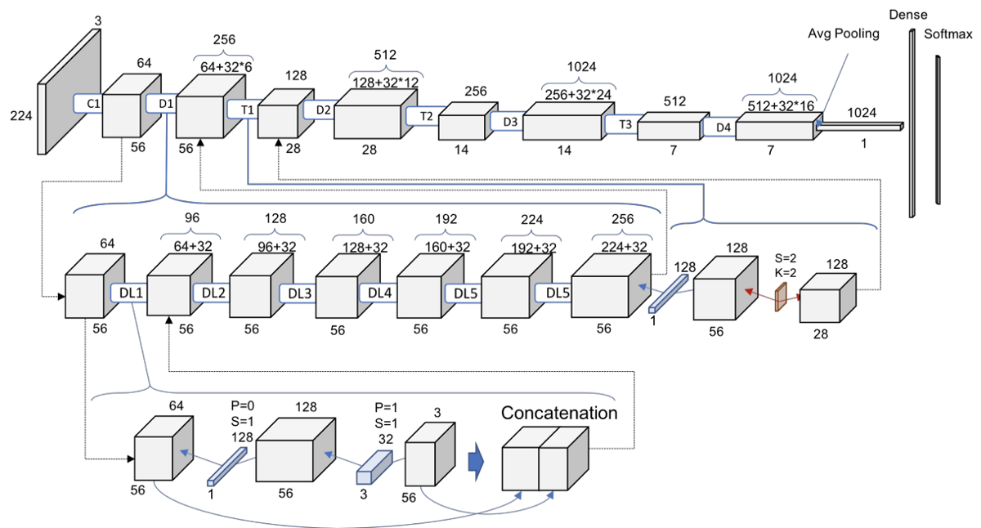
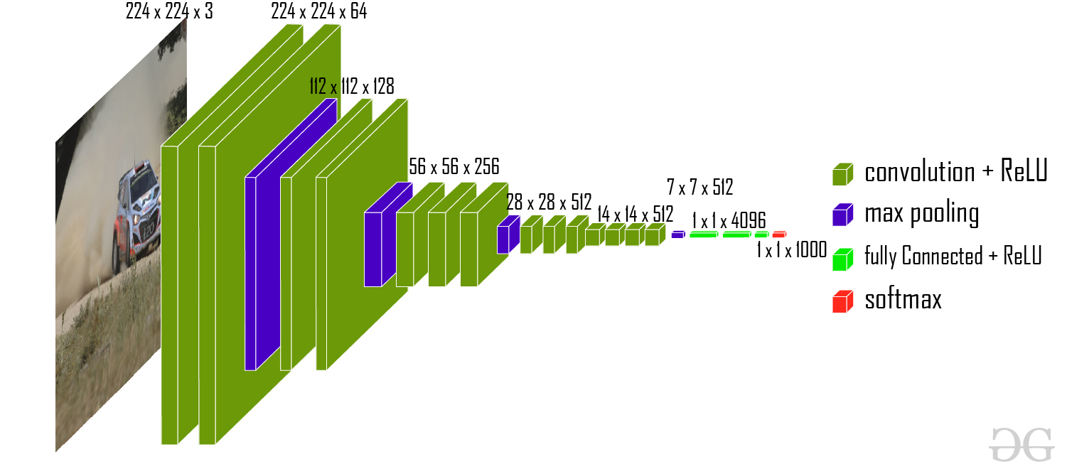
Multi-Label Image Modeling
CNN-RNN architectures
(Zanoci and Andress, 2017)’s Binary Decoder RNN Model.
Used a sigmoid.
Small Data:
(Brigato and Iocchi, 2020) demonstrated that model complexity is linked to performance.
Less complex models with less parameters tend to work better.
CNN Backbones:
ResNet18/50/101
DenseNet121/169/201
VGG11/16/19 with Batch Normalization
All pretrained on ImageNet
Experimented treating labels as independent and dependent.
Notes:
As mentioned in the literature review, CNN-RNN architectures are able to learn a joint image-label representation to identify the semantic label dependencies.
Largely inspired by (Zanoci and Andress, 2017), we used their Binary Decoder RNN Model.
The model runs for a number of time-steps equal to the number of labels (22 in our case), where the hidden state at each step is fed into a fully connected layer and outputs a single scalar, with the end result being a vector of length 22. Unlike in the original paper, we used a sigmoid activation at the end of each fully connected layer.
(Brigato and Iocchi, 2020) demonstrated that model complexity plays a large role in the ability of CNNs to model small amounts of data. More specifically, less complex models with less parameters tend to work better.
Chose to use ResNet, DenseNet, and VGG with BN as backbones. These were chosen to have a variety in size and complexity.

Slide 16
Methodology: Text Modeling

Slide 17
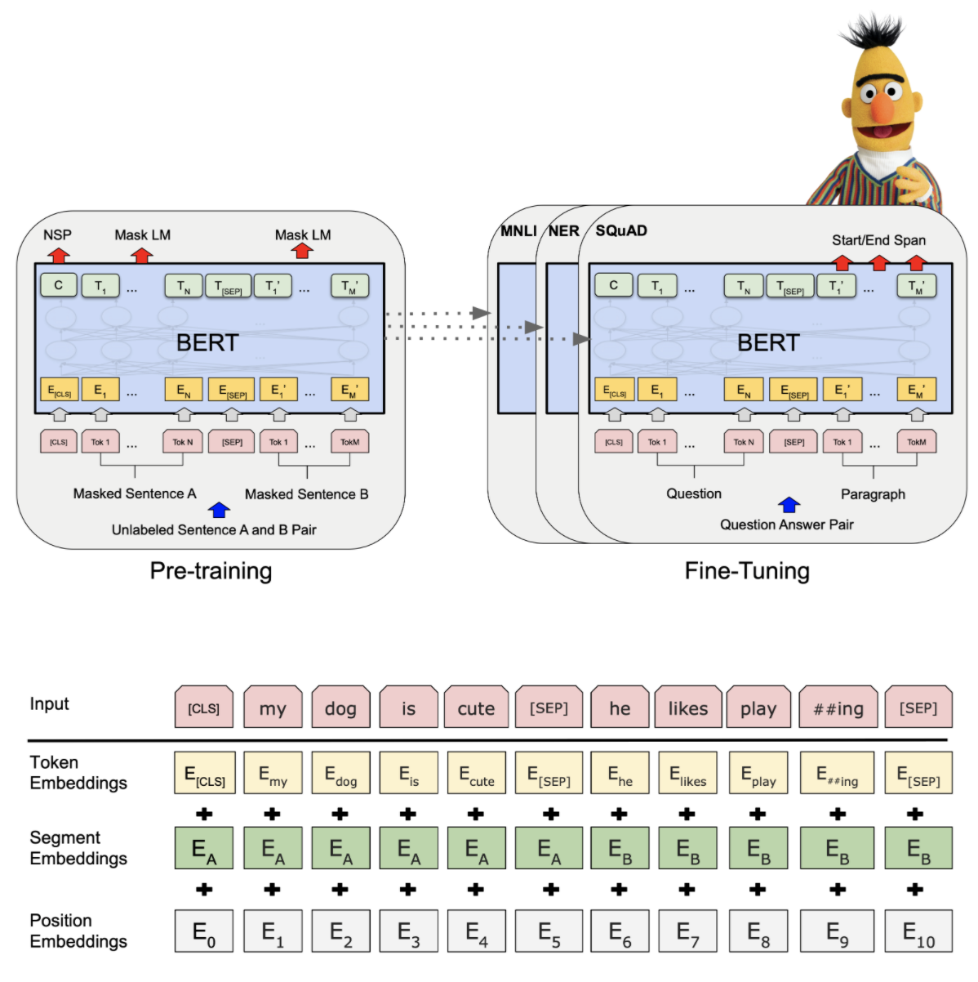
Multi-Label Text Modeling
Simple Models
Linear
Tree Based
Complex Models
Bert
Distilbert
Source: Neural Analytics
Notes:
The text modeling included experimentation of multiple models with and without augmentation of the hate and sentiment metadata.
The simple models that were compared were as follows: knn, Decision Tree, Bagging, Random Forest, Boosting, Multinomial Naive Bayes, SVM, Powerset SVM.
The winner of the simple models was Random Forest.
With the complex models the team created a Bert and Distilbert model.
The final model selection for the Text component is the DistilBert Model. This was for a couple of reasons: state of the art (or recent) model architecture, ease of fine tuning model and running multiple experiments (due to reduced processing time).

Slide 18
Methodology: Multi-Modal Fusion

Slide 19
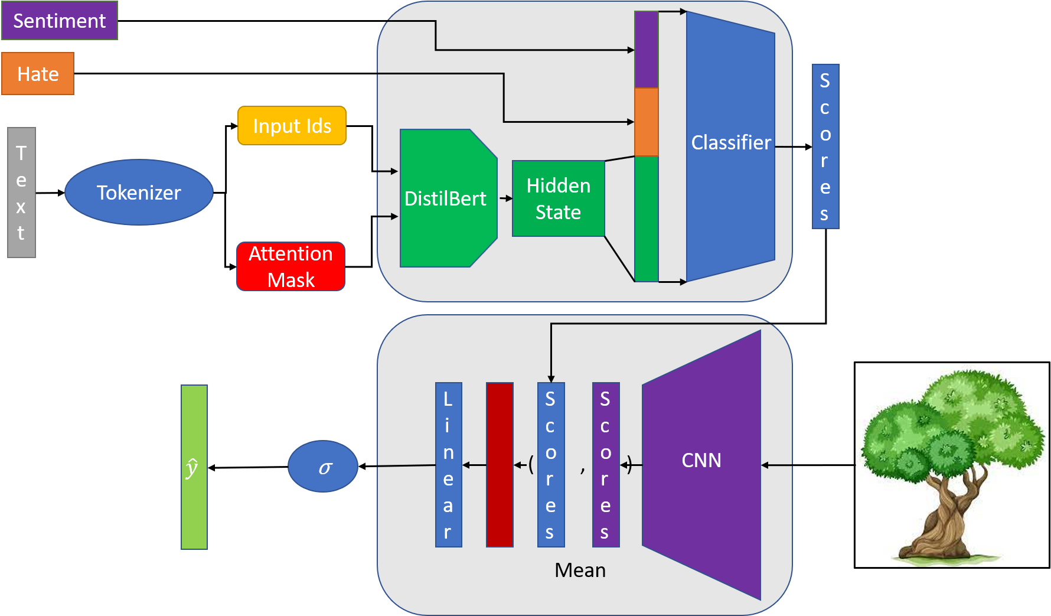

Slide 20
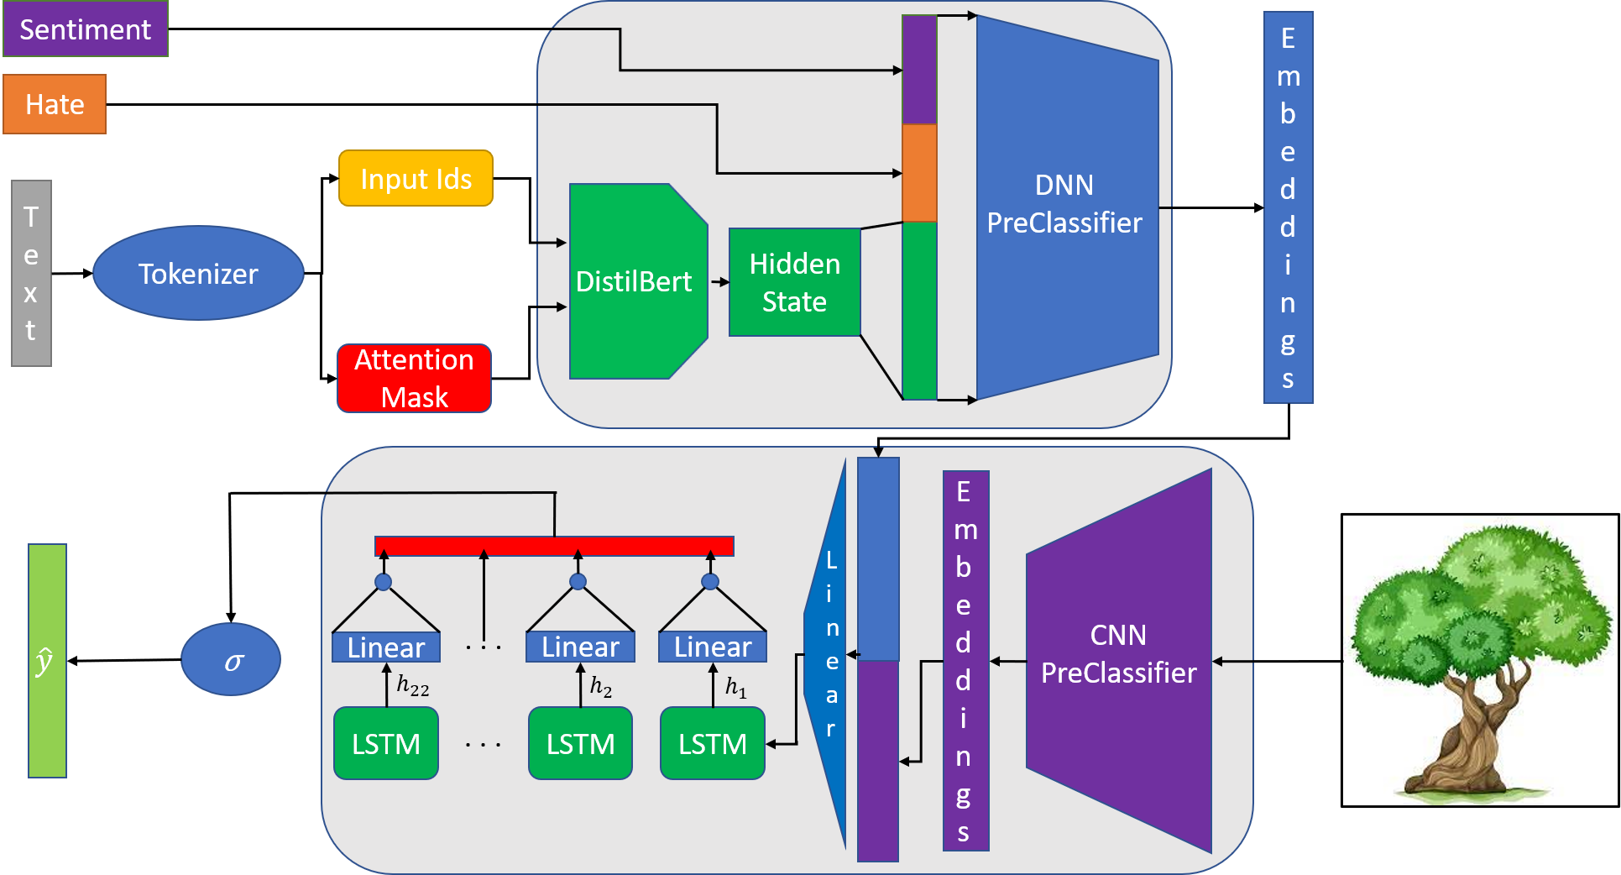

Slide 21
Methodology: Loss & Evaluation Metric

Slide 22
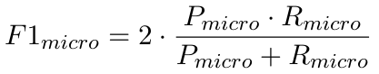
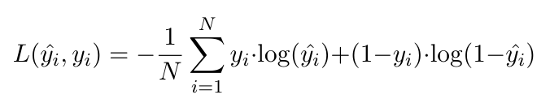
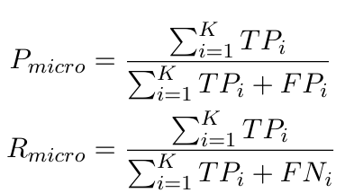
Loss & Evaluation Metric
Loss:
Binary Cross Entropy
Evaluation Metric:
F1 Micro Score (Used in SemEval Competition)
P = Precision, R = Recall
TP = True Positive, FP = False Positive, FN = False Negative.

Slide 23
Analysis

Slide 24
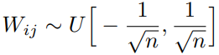
Experiments
Image Only, Multi-Modal Models:
10-fold Cross Validation
30 epochs per fold
Optimizer: Adam
Initial Learning Rate: 0.01
Reduced by factor of 10 if validation loss doesn’t improve after 5 epochs.
CNN-LSTM:
Hidden Sizes = (500, 700)
Number of Layers = 1
Dropout = (0, 0.5)
LSTM weights preset using Glorot initialization (Glorot and Bengio, 2010)
LSTM biases = 0
Same for final prediction layer.
Model with highest with highest F1 score across folds & epochs is chosen as best for each experiment.
Text Models:
15-fold Cross Validation
7 epochs per fold
Optimizer: Adafactor
Initial Learning Rate: None
Model auto-determines best learning rate using a sub-linear memory cost algorithm
DistilBert:
Hidden State = (1024, 768)
Number of Layers = 6
Number of Heads = 12
Pre-Initialized via distillation process from BERT
Model was selected at the indicated cross validation fold and epoch due to best performance for F1 Score.
n = size of previous layer
Notes:
The text model utilized a 15 fold and 7 epoch cross validation data loading strategy. The optimizer selected was Adafactor, as opposed to Adam because it gave similar results but performed faster and had a smaller memory footprint. The initial learning rate was set to none and Adafactor determines the best learning rate using a sub-linear memory cost algorithm. The specific hyperparameters for distilbert are as follows a 1024 x 768 hidden state + 2 additional feature dimensions from hate and sentiment. The final dimensions as the last step of fully connected was 24 (representing the final amount of label classes). Distilbert has 6 layers and 12 attention heads and it came pre-initialized from the distillation process from a BERT model.
Note: Adafactor is a stochastic optimization method based on Adam that reduces memory usage while retaining the empirical benefits of adaptivity. This is achieved through maintaining a factored representation of the squared gradient accumulator across training steps.

Slide 25
Results

Slide 26

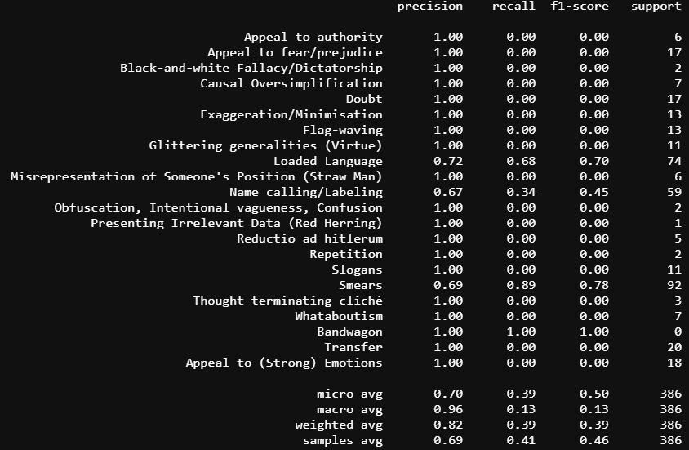
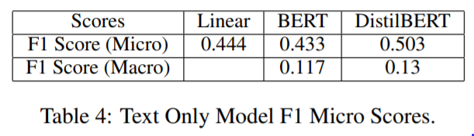
Text Results
Source: Perfect Search Media
Notes:
Earlier the research team stated their reasons for selecting DistilBert. By the numbers, the Distilbert model performed the best. The DistilBert only got a better score because it permitted the team to experiment with different fine-tuning parameters since the distilbert model processes faster.
Not much to tell from the results of the Distilbert multi-label text classification. The model scored a .50 f1. micro average. This is a bit misleading though since the data was highly unbalanced and so were the predicted classifications. For the higher volume classes, the model performed well. That cannot be said for the lower volume classes.

Slide 27
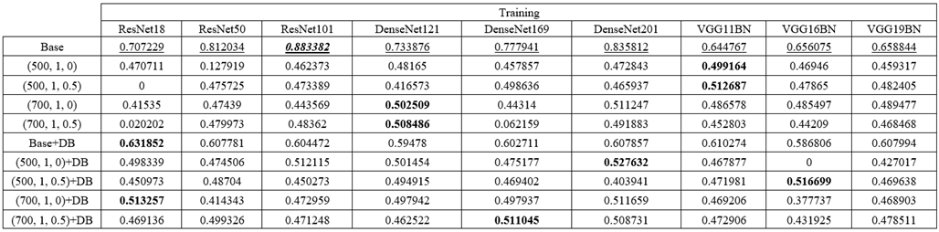
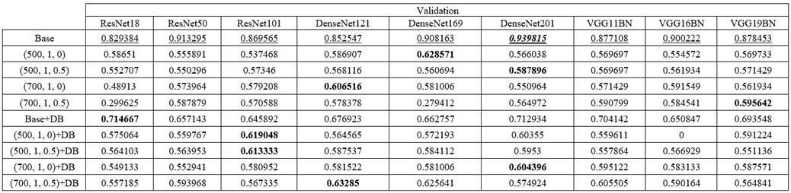
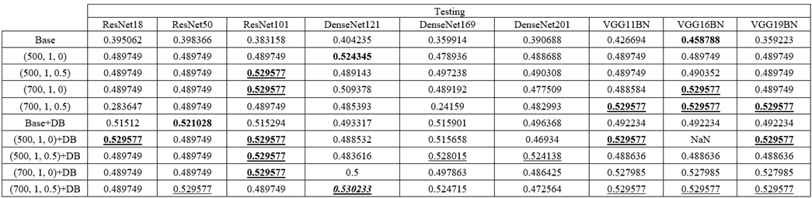
F1 Micro Scores
Bold = Best by Experiment
Underline = Best by Model
Bold, Underline, Italics = Best Overall
Base = Original CNN model
(H, L, D) = CNN-LSTM; H = Hidden Size, L = Number of Layers, D = Dropout
Base+DB = Original CNN model fused with DistilBert.
(H, L, D)+DB = CNN-LSTM fused with DistilBert.
Base models performed best in Training and Validation.
All models underperformed in Testing.
Multi-Modal models performed only marginally better in some cases.
However, best overall model was a Multi-Modal model with CNN-RNN base.

Slide 28
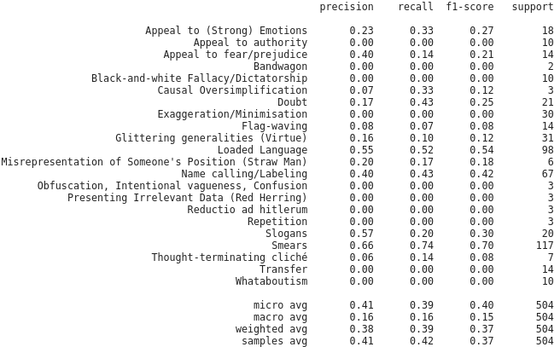

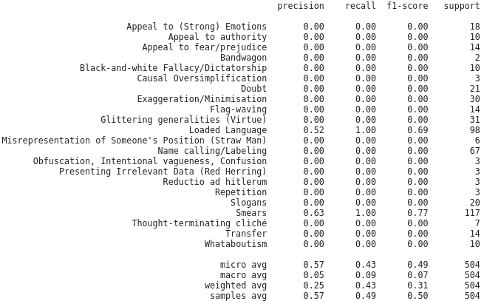

Classification report of ResNet50 Base
Classification report of ResNet50 Base + DB
Classification report of ResNet50-LSTM(500,1,0)
Classification report of ResNet50-LSTM(500,1,0) + DB

Slide 29
Challenges & What could have been done differently?

Slide 30
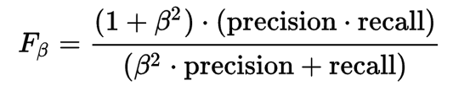
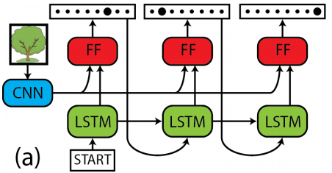
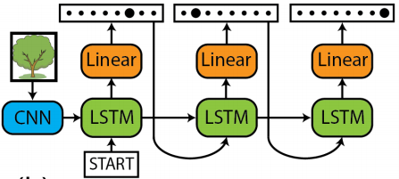
Challenges:
Very small data size
Highly unbalanced data
Unnatural images
Abstractness of Labels
What could have been done differently:
Use F_𝛃 score:
Better for unbalanced data.
𝛃 < 1: Precision in given more weight
𝛃 > 1: Recall in given more weight
𝛃 = 1 = F1: Precision & Recall weighted the same.
Use different CNN-RNN architecture
(Zanoci and Andress, 2017) also tested a Label-Only RNN model and a Captioning RNN model.
Removing text from image for modeling
Different image model optimizer
Don’t used ImageNet pretrained models
ImageNet uses natural images.
Pretrain image models on similar data
Hard to find.
Use a transformer instead of LSTM
Transformers recently have been shown to be better than RNNs.
Implement a beam search to determine labels
Label-Only RNN Model
Captioning RNN Model
Notes:
When we care more about minimizing false positives than minimizing false negatives, we would want to select a beta value of < 1 for the F-beta score. In other words, precision would be given more weight than recall in this scenario.
When the priority is to minimize false negatives, we would want to select a beta value of >1 for the F-beta score. Recall would be considered more important than precision in this scenario.
In (Zanoci and Andress, 2017) paper, they used an F2 score.

Slide 31
Additional Challenges
Visualizing components
Explainability of Model Results
Experiment with other Text Classifiers (Deep Neural Networks)
Balance Data by using Model Weights
Derive more metadata using NLP techniques
Notes:
One of the hardest things for DNNs is the explainability. So visualizing the model hidden states and the inner workings would go a long way in explainability. Other options would include using techniques like SHAP to help determine which features are more important in driving model behavior. Experiment with other advanced and state of the art Deep Neural Networks like GPT - 3 or T5. Modify algorithm to weight results to correct for class imbalance. Lastly, use NLP techniques to generate additional metadata such as word counts, ngrams and other technques.

Slide 32
Conclusion

Slide 33
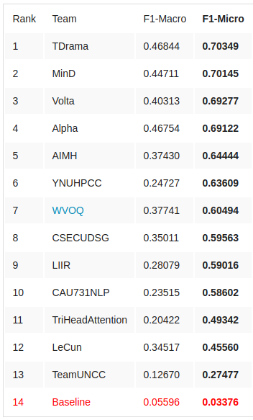
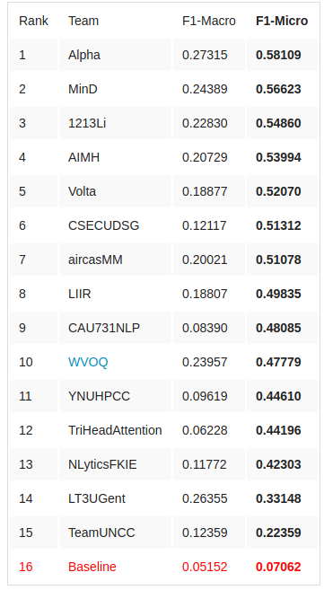
How Do We Match Up?
Dev Set
Test Set
Not too bad.
We would have been 1st in the dev set. Base ResNet18 with DistilBert had a F1 micro score of 0.714667.
Would would have been 5th in the test set. DenseNet121+LSTM(700, 1, 0.5) with DistilBert had an F1 micro score of 0.530233.
However, take this with a grain of salt:
We combined the data. Had more training data.
Validation does not equal dev.
Less test data than competition.
Knew the test data labels.

Slide 34
Summary
Memes are an active and challenging area of research.
Their multi-modal and unnatural qualities make them hard to model.
Our methods and project demonstrate this.
Gonk Droid - Source: starwars.fandom.com

Slide 35
References

Slide 36
Cristian Zanoci and Jim Andress. 2017. Exploring cnn-rnn architectures for multilabel classification of the amazon.
L. Brigato and L. Iocchi. 2020. A close look at deep learning with small data.
Xavier Glorot and Yoshua Bengio. 2010. Understanding the difficulty of training deep feedforward neural networks. In Proceedings of the Thirteenth International Conference on Artificial Intelligence and Statistics, volume 9 of Proceedings of Machine Learning Research, pages 249–256, Chia Laguna Resort, Sardinia, Italy. PMLR.
Julia Kruk, Jonah Lubin, Karan Sikka, Xiao Lin, Dan Jurafsky, and Ajay Divakaran. 2019. Integrating text and image: Determining multimodal document in-tent in instagram posts.CoRR, abs/1904.09073.
Shardul Suryawanshi, Bharathi Raja Chakravarthi, Mihael Arcan, and Paul Buitelaar. 2020. Multimodal meme dataset (multioff) for identifying offensive content in image and text. In Proceedings of the Second Workshop on Trolling, Aggression and Cyber-bullying, pages 32–41, Marseille, France. European Language Resources Association (ELRA).
Jiang Wang, Yi Yang, Junhua Mao, Zhiheng Huang,Chang Huang, and Wei Xu. 2016. Cnn-rnn: A unified framework for multi-label image classification. pages 2285–2294.
Jacob Devlin, Ming-Wei Chang, Kenton Lee, and Kristina Toutanova. 2019b. BERT: Pre-training of deep bidirectional transformers for language understanding. In Proceedings of the 2019 Conference of the North American Chapter of the Association for Computational Linguistics: Human Language Technologies, Volume 1 (Long and Short Papers), pages 4171–4186, Minneapolis, Minnesota. Association for Computational Linguistics.
Victor Sanh, Lysandre Debut, Julien Chaumond, and Thomas Wolf. 2020. Distilbert, a distilled version of bert: smaller, faster, cheaper and lighter.
Douwe Kiela, Hamed Firooz, Aravind Mohan, Vedanuj Goswami, Amanpreet Singh, Pratik Ringshia, and Davide Testuggine. 2020. The hateful memes challenge: Detecting hate speech in multimodal memes.
Tariq Habib Afridi, Aftab Alam, Muhammad NumanKhan, Jawad Khan, and Young-Koo Lee. 2020. A multimodal memes classification: A survey and open research issues.

